Slide 1


SMART BUS STOP INDICATOR
SENGUNTHAR ENGINEERING COLLEGE
(AUTONOMOUS)
Team Members:
Rithishmani.R
Viswanathan.S
Under the Guidence of:
Ashok Kumar.K , ME (phd).

Slide 2
Objectives:
ABSTRACT
INTRODUCTION
BLOCK DIAGRAM
WORKING OF SYSTEM
CONCLUSION

Slide 3
Abstract:
In this paper we present bus a system which kept stationary at the bus-stand and system which kept at bus that can effectively help the public to participate in bus transportation facilities to its fullest. A bus that is coming toward the bus –stand is identified by this passenger infotainment system and the details of that particular bus is provided to the passenger on display at bus-stand. Bus location identified using GPS & same will be announce in Bus This information send to next bus stand for passengers. The bus identification process involves usage of Radio Frequency technology and bus details are announced by Voice and displayed in Liquid Crystal Display (LCD) unit. The summary of current research provides details about the integration between Microcontroller and RF transceiver, GSM and GPS LCD display, Voice Announcement.
Keywords: GPS, GSM, Passenger Information System, RF technology, Voice Announcement.

Slide 4
Introduction:
Wireless communication can be defined as transfer of information between two or more points without using wires or cables. There are different wireless technologies such as RFID, IR, GPS, Bluetooth, and WI-FI, etc. In olden days location announcement was done with the help of speakers, but now it is developed by using IVRS in railways stations. Nowadays bus location can be found with the help of Geo Positioning satellites.
This bus location announcement system is very helpful for people who are blind, illiterates and new to cities. This system can be applied in different areas like transport companies, public trains, private travels, government travel agencies, service organizations, etc.
With the advent of GPS and the ubiquitous cellular network, real time vehicle tracking for better transport management has become possible. These technologies can be applied to public transport systems, especially buses, which are not able to adhere to predefined timetables due to reasons like traffic jams, breakdowns etc. The increased waiting time and the uncertainty in bus arrival make public transport system unattractive for passengers. A RealTime Passenger Information System uses a variety of technologies to track the locations of buses in real time and uses this information to generate predictions of bus arrivals at stops along the route.

Slide 5
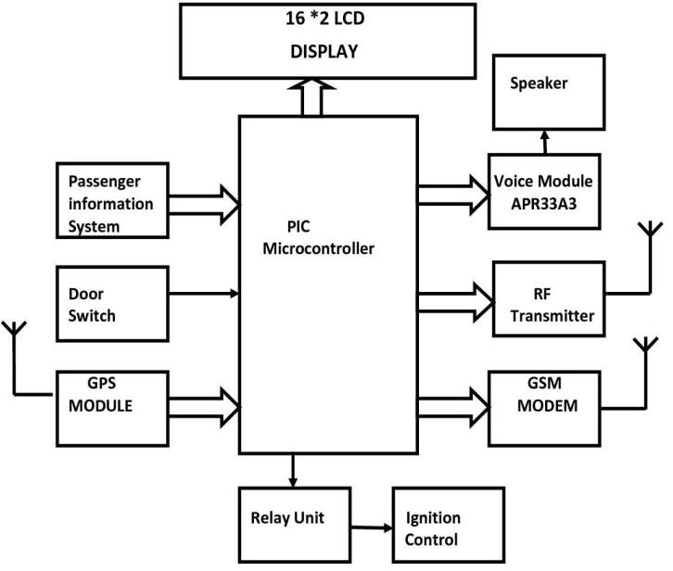
Block diagram:
a) System in Bus

Slide 6
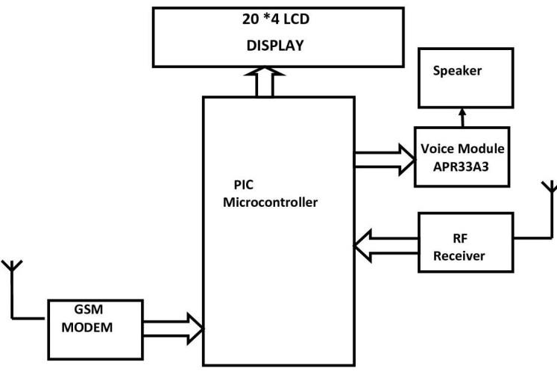
b) System at Bus Stand

Slide 7
WORKING OF SYSTEM
This project consists of two sections, first section is transmitter which is placed in bus. Transmitter section consists of a PIC microcontroller, a GPS module, GSM Modem, Voice recording/Playback unit AR33A3, RF transmitter, Door switch, relay unit and a LCD Display. This entire circuit is placed inside a bus or train. The power supply provides the voltage to entire circuit. The GPS modem consists of a receiver that receives the signals from the satellites based on latitude, longitude and altitude. These coordinate values are stored in the microcontroller. These coordinates represent the bus or train locations. These coordinates’ values are compared with the values from the GPS receiver. These coordinated values are equal to the latest coordinates coming from the GPS modem and are converted into TTL level with the help of MAX 232. If the latest values match with the stored coordinates values in the microcontroller, it displays the location name on the LCD display, and then announces the stop name by using the Speaker IC. When bus stop at bus stand Microcontroller check the door status, if door open then microcontroller not give the permission to start bus until door close. This avoids accident due to door open of bus

Slide 8
When bus ready to departure for next bus stop, microcontroller send information of bus to next station to aware passenger that bus will come in few time. Bus continue send information of bus i.e. Bus number, route, number of passenger seat vacant on RF transmitter. When bus coming near to bus stand approximately 100meter, receiver system at bus stand detect information & display all details of on display & make announcement automatically on Bus stand.
This is all about the GPS technology and microcontroller-based project for bus location announcement system that uses GPS technology.

Slide 9
CONCLUSION
In our project we develop an embedded system which is an used for tracking the bus position, give the information about number of seats available in the bus and information about the route, bus number. The future enhancement is developing a system by using server and ticket collecting machine.
The goal of this project work is to assist the blind people, illiterate people, and new people in city. Specially, we search for different aid for blind people rather than obstacle detecting blind stick, because this kind of technology available everywhere and hence we thought in different angle to develop a portable Electronic bus number announcing appliance. Finally, we are able to reach the target.

Slide 10
We feel that lot of modifications must be carried over to design a sophisticated engineering module. We will handle this as our future work or scope of project work. Several directions for future work are immediately obvious. In particular, before conducting another round of user studies, we plan to implement all suggestions given by research participants in this project work. In addition, we would like to implement some of the features originally planned in the conceptual design of the project work. In particular, we would like to implement GPS based navigation system for the blind such that wherever they go within the specific permitted area, that particular area name must be announced, this our final target. As the technology advances, particularly in the field of world-wide communication networks Global Positioning Systems are playing dominant roll. In most applications, these devices are used as vehicle tracking systems falls in the field of ground navigating systems. But in addition to these applications, variety of services can be provided to the blind people. In this regard here this system - will be modified as our future work which is aimed to serve the blind persons by announcing the area name wherever they go with in a pre-defined area.

